Slide 1
地理时空数据可视分析

Slide 2
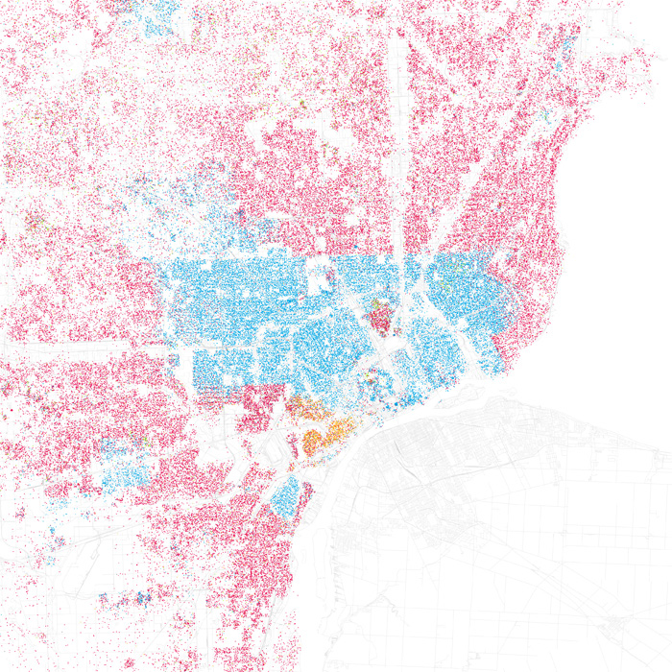
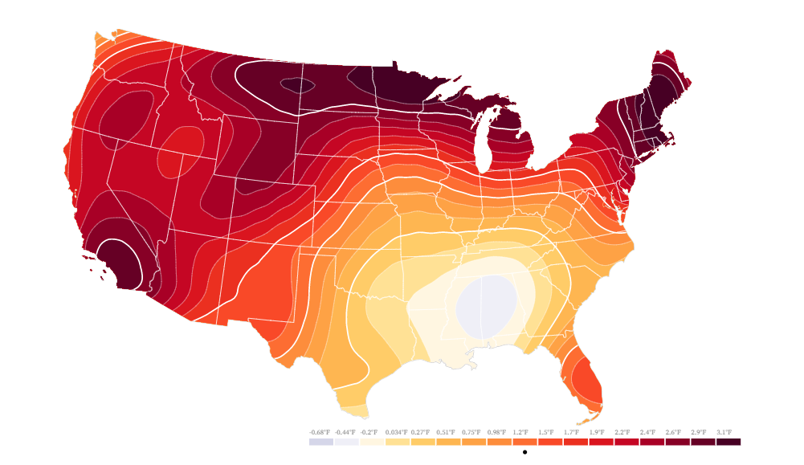
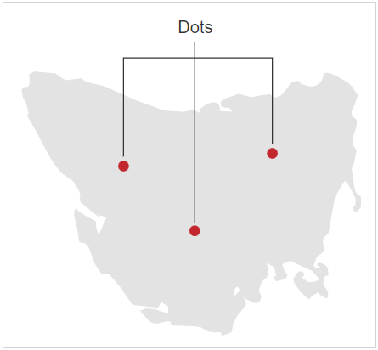
Dot Map
Density Map / Contour Map
Notes:
Dot Map: https://observablehq.com/@aboutaaron/racial-demographic-dot-density-map
Density Map: https://observablehq.com/@efrymire/gridding-map-files

Slide 3
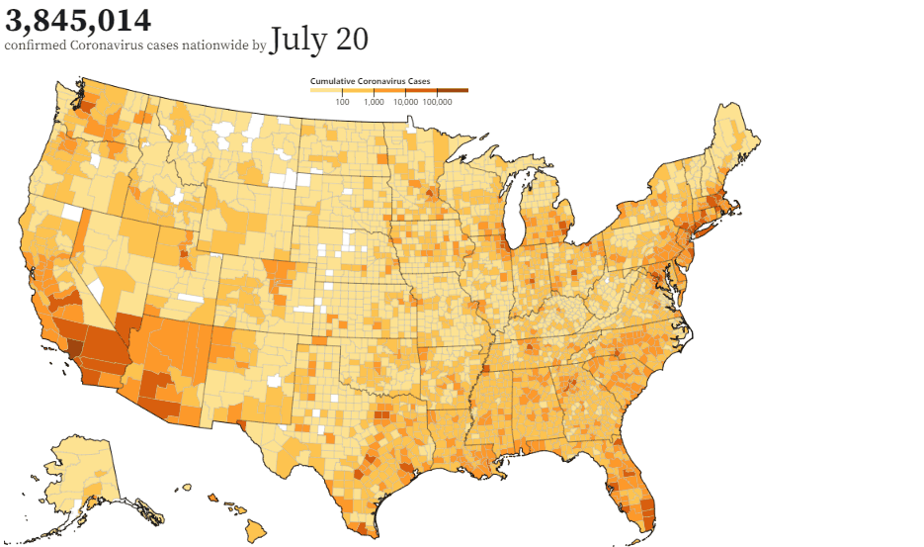
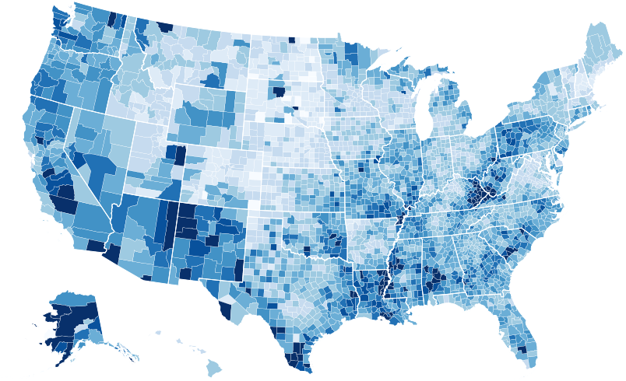
Choropleth Map
+Time
Notes:
Choropleth Map: https://observablehq.com/@d3/choropleth
Temporal Choropleth Map: https://observablehq.com/@clhenrick/u-s-coronavirus-cumulative-cases-animated-map
分级统计图

Slide 4
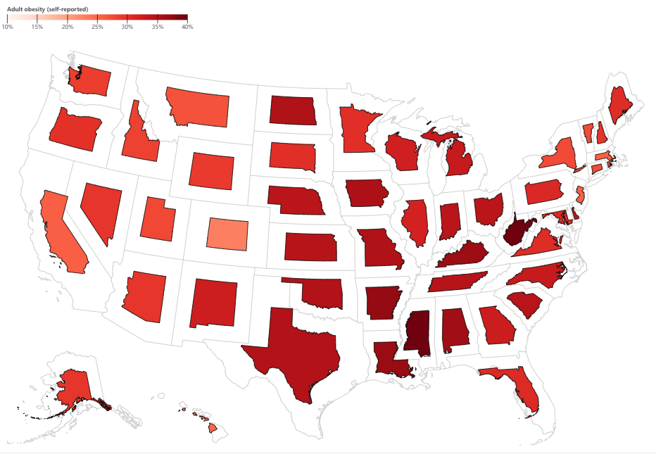
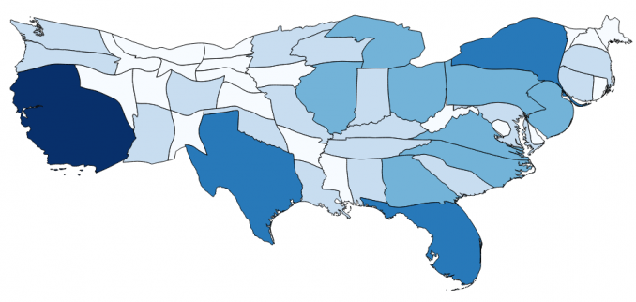
Contiguous Cartogram
Non-Contiguous Cartogram
Notes:
Cartogram: https://observablehq.com/@ambassadors/lets-make-a-dougenik-cartogram
Non-Contiguous Cartogram: https://observablehq.com/@d3/non-contiguous-cartogram
示意地图

Slide 5
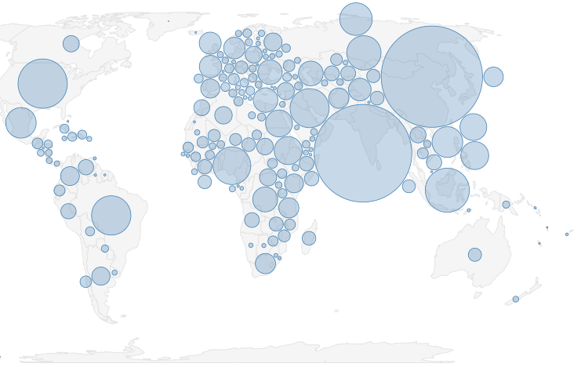
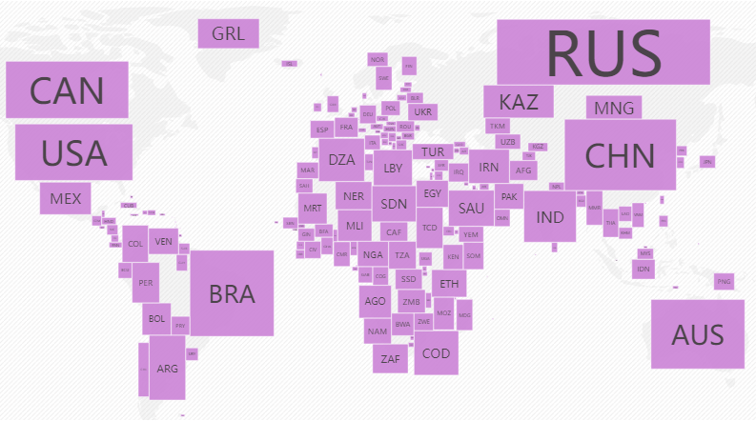
Demers Cartogram
Dorling Cartogram
Notes:
Demers Cartogram: https://observablehq.com/@neocartocnrs/rectangle-cartogram
Dorling Cartogram: https://observablehq.com/@harrystevens/dorling-cartogram
Dorling地图（以Danny Dorling教授的名字命名）使用圆形和矩形等形状来描绘区域。这些类型的地图使识别模式变得容易。

Slide 6
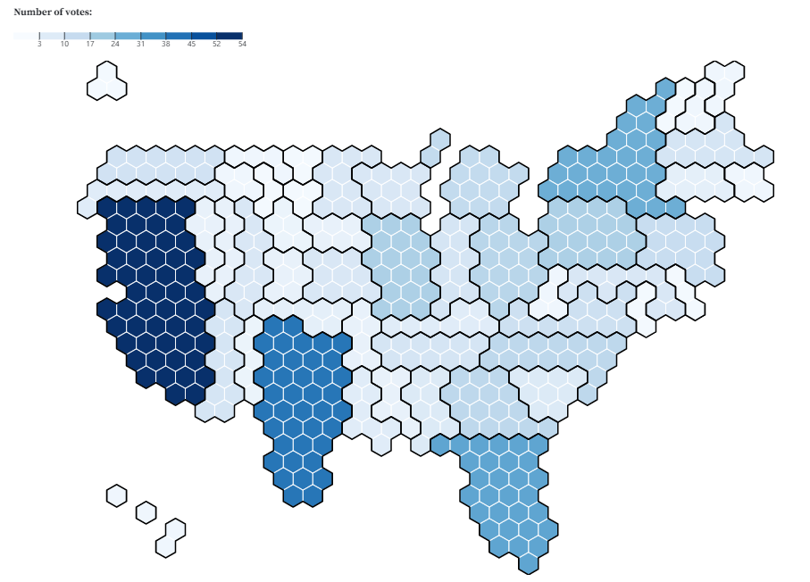
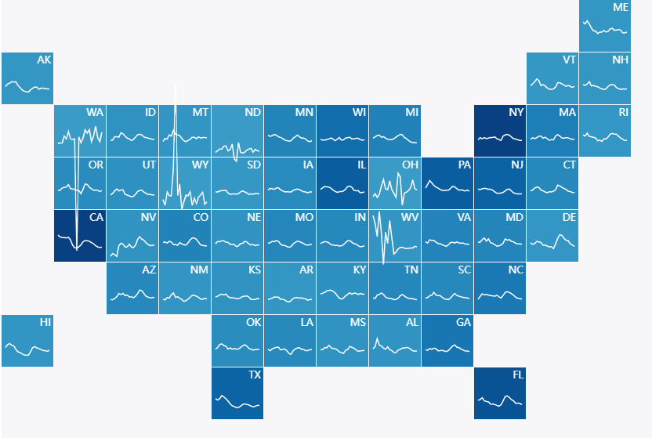
Grid Map / Tiled Map
Hexbin Map
Notes:
Grid Map: https://observablehq.com/@aymericr/tiled-map
Hexbin Map:
https://observablehq.com/@d3/hexbin-map
https://observablehq.com/@ambassadors/the-new-electoral-college

Slide 7
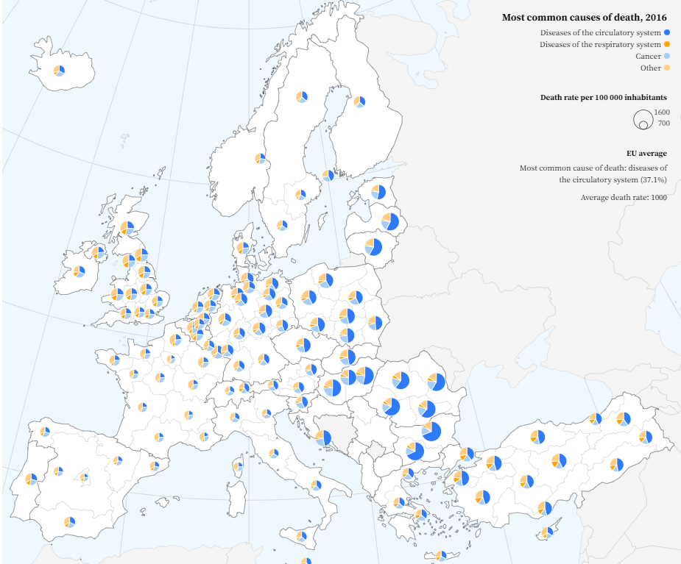
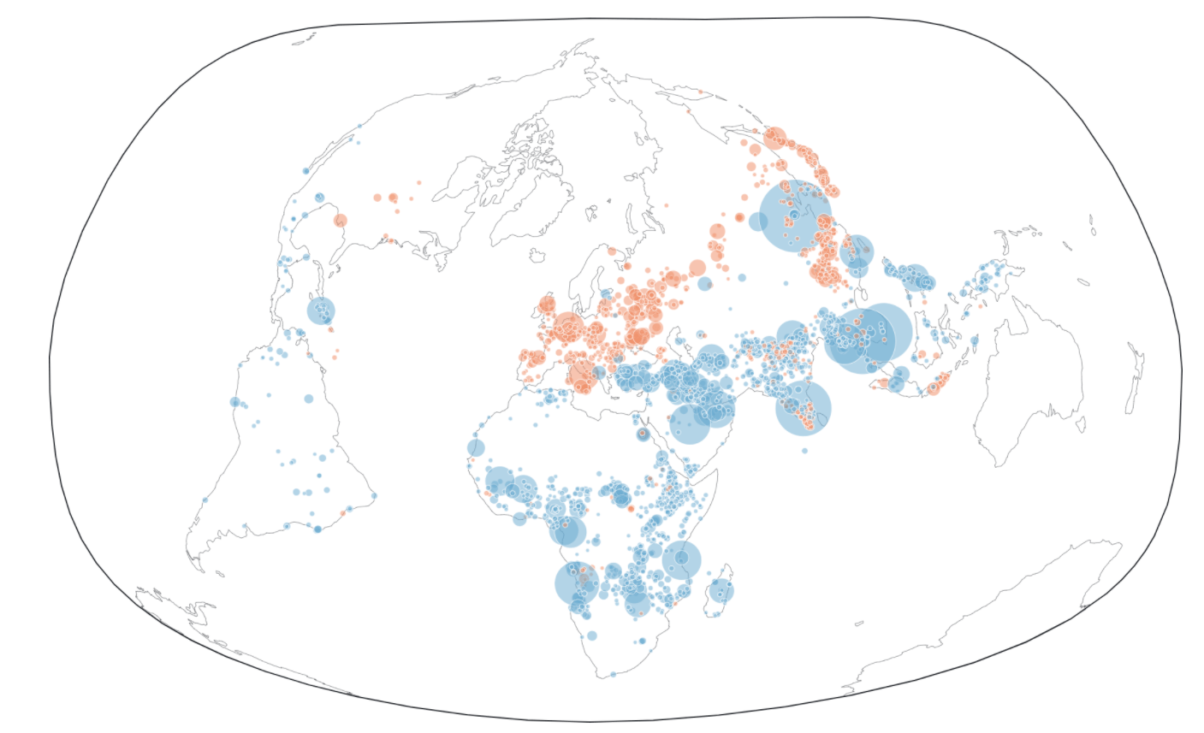
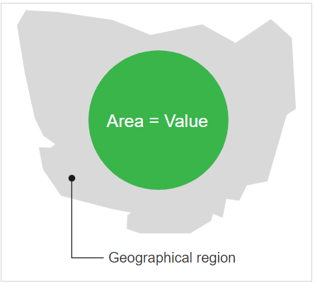
Bubble Map
Pie Chart on Map
Notes:
Bubble map: https://observablehq.com/@visionscarto/ghsl-growing-and-declining?collection=@visionscarto/30daymapchallenge
Pie chart on the map: https://observablehq.com/@joewdavies/mapping-with-pie-charts-most-common-causes-of-death-in-europ

Slide 8
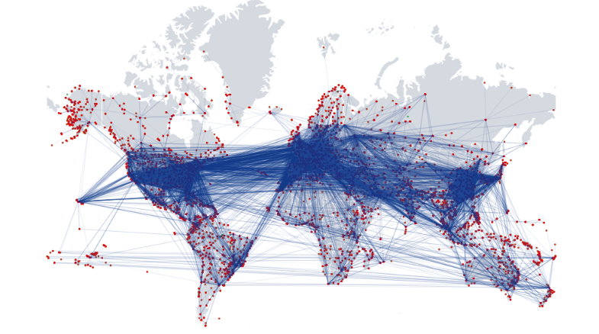
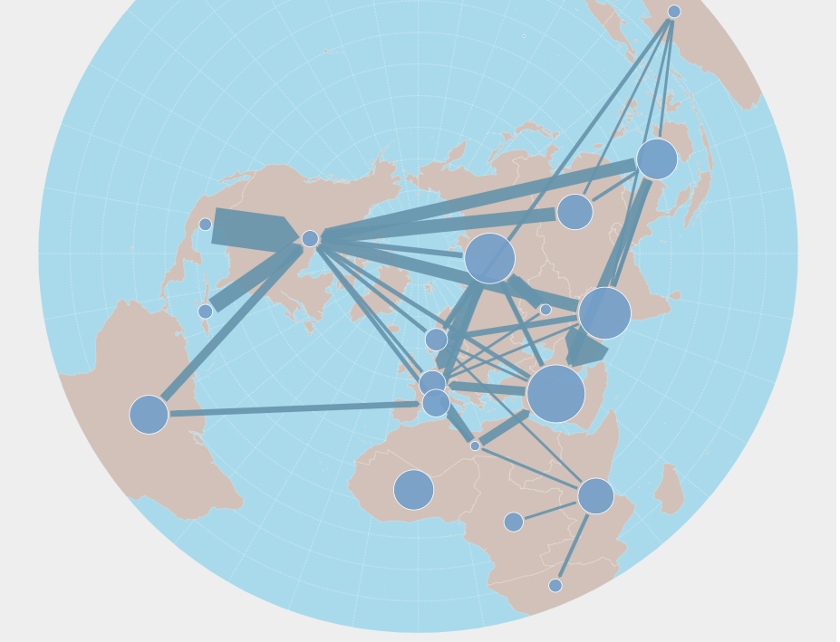
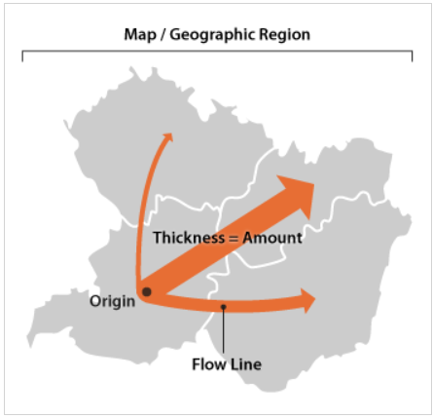
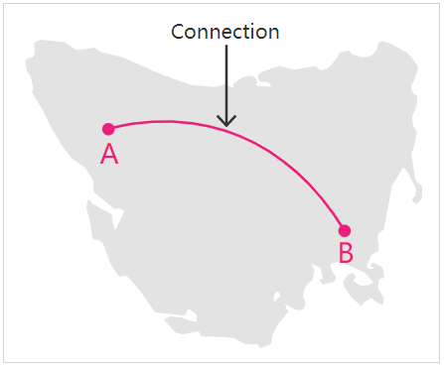
Connection Map
Flow Map
Notes:
Connection Map: https://observablehq.com/@alhenry/data-viz-course-ebi-exercise
Flow Map: https://observablehq.com/@neocartocnrs/flow-map

Slide 9


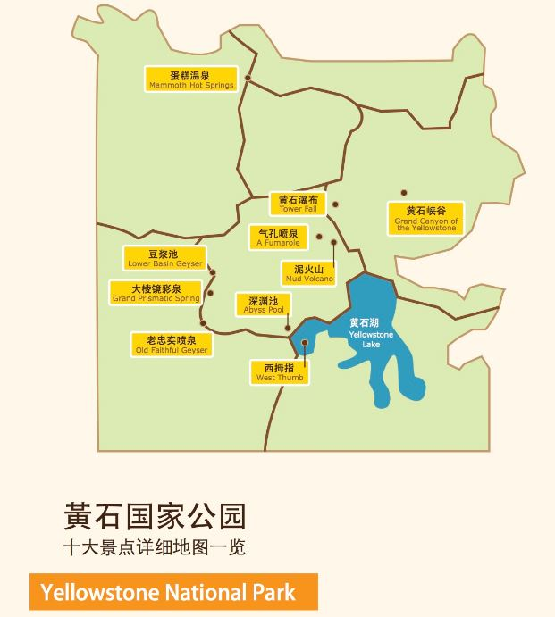




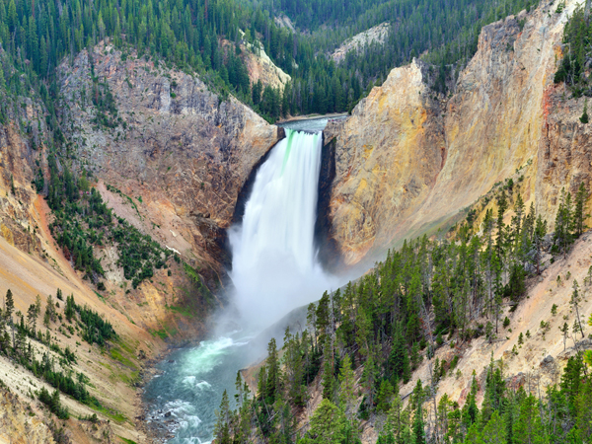

数据集
(lat, lon)
date
owner
title
(id, url)
年份
2010
2020
共57k+条记录

Slide 10
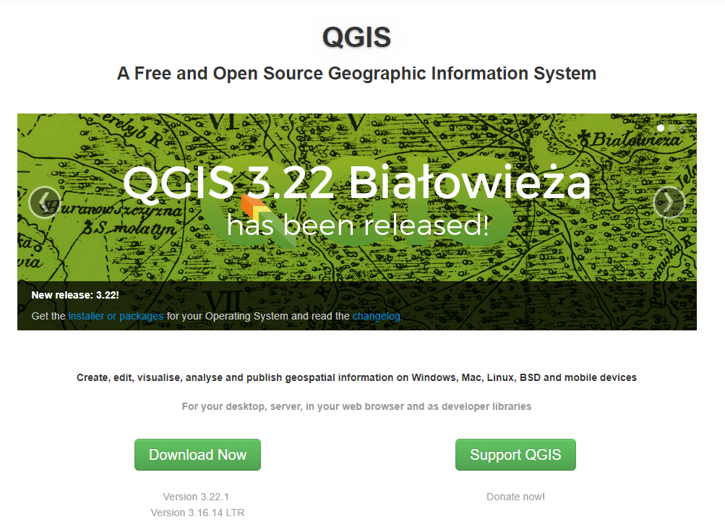
QGIS
主要功能
-浏览数据与地图设计
- 建立、编辑、管理与输出数据
- 地理数据分析
- 各种附加组件

Slide 11
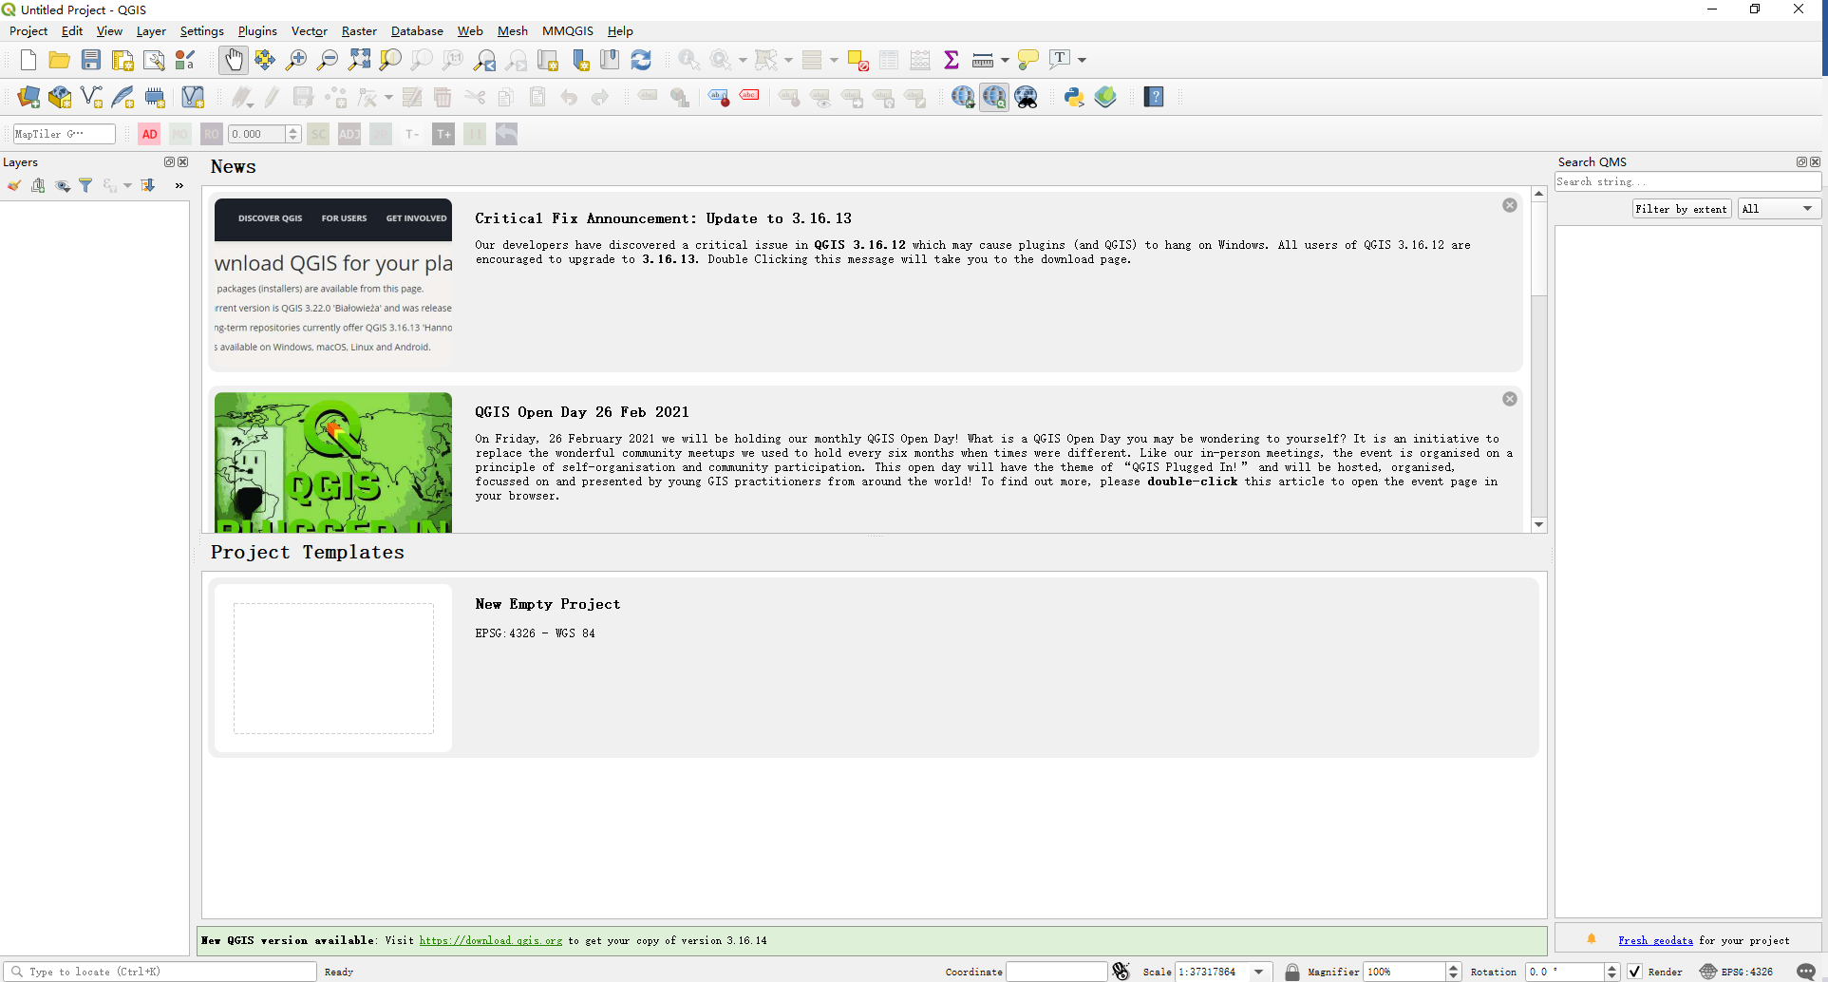

Slide 12
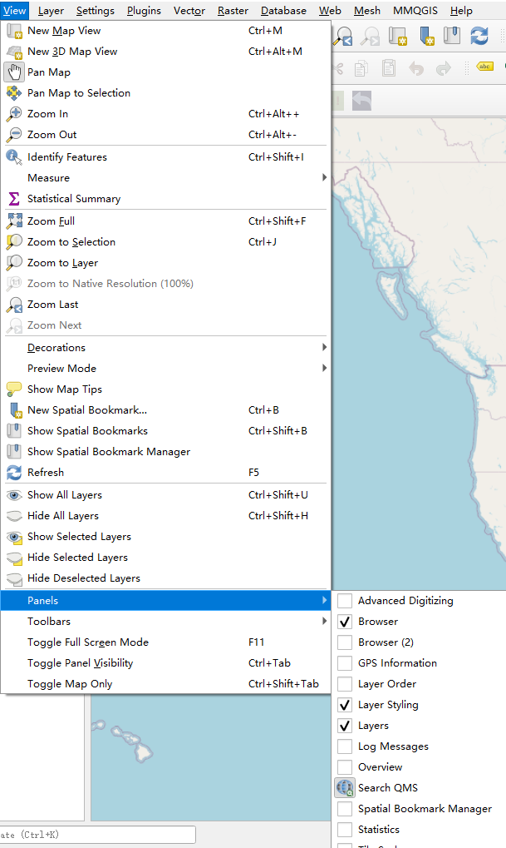
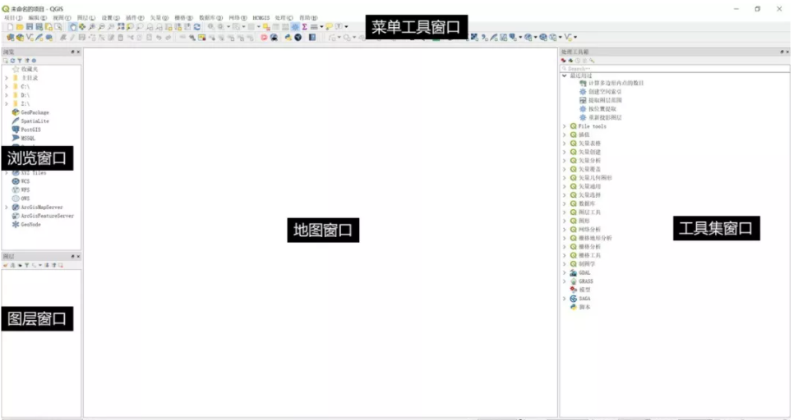

Slide 13
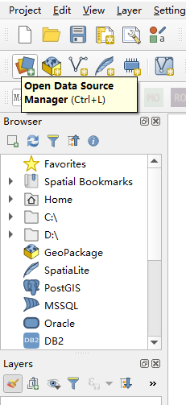
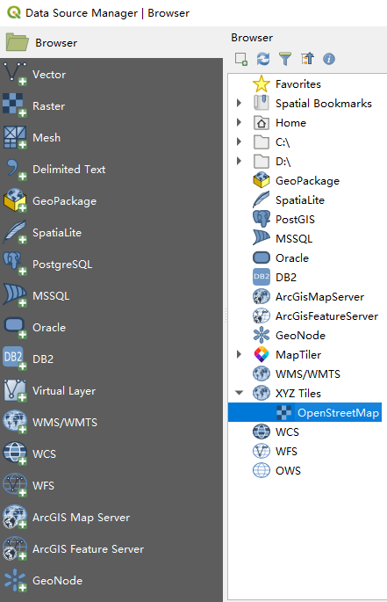
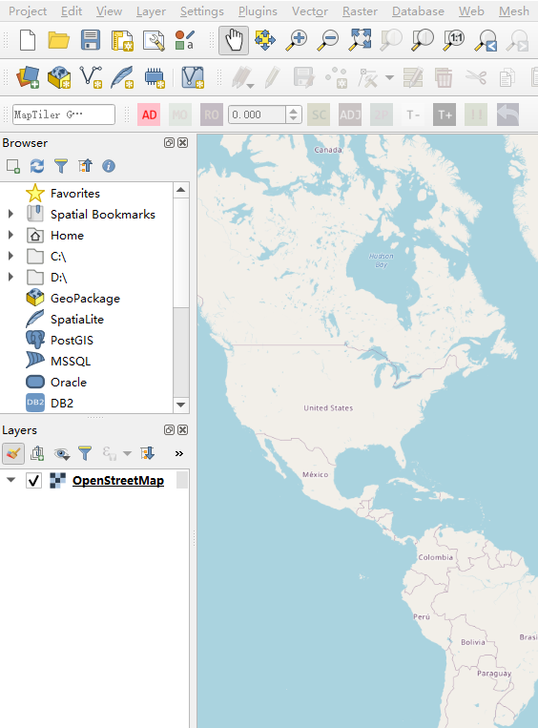
2
1
3
双击

Slide 14
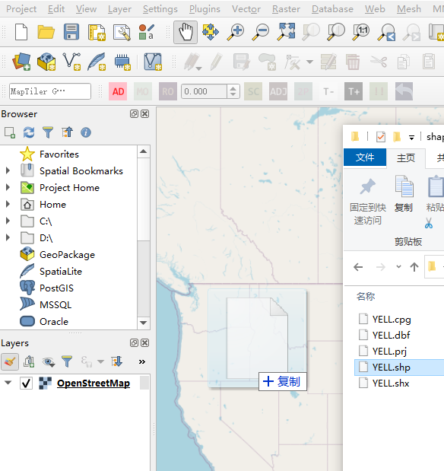
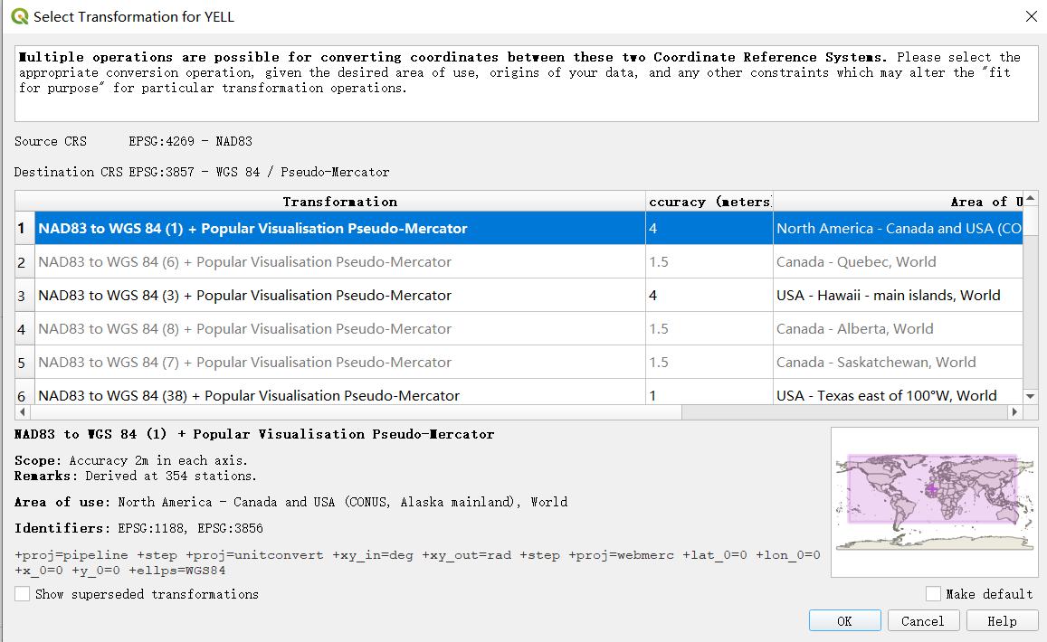
2
1

Slide 15
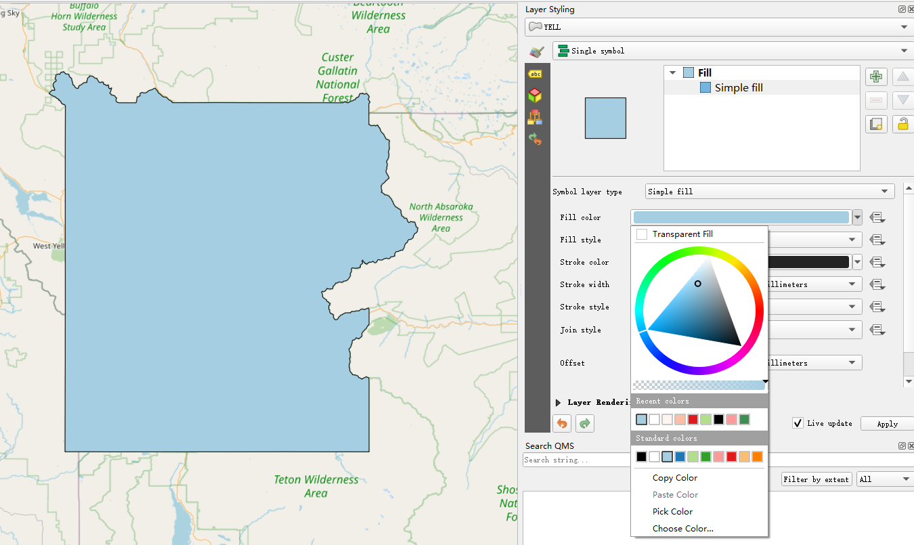
1
2
3

Slide 16
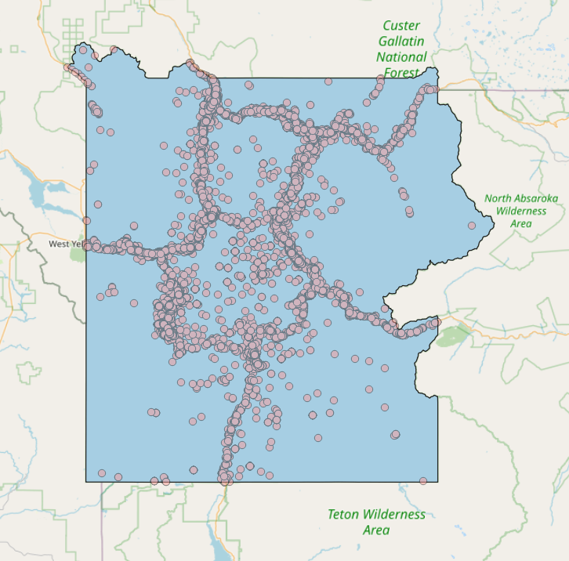

Slide 17
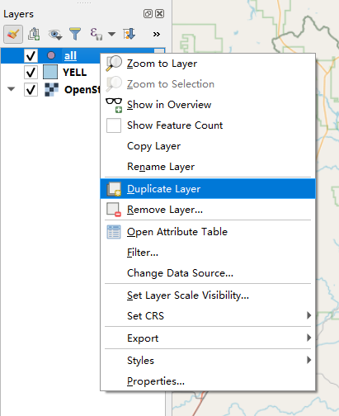
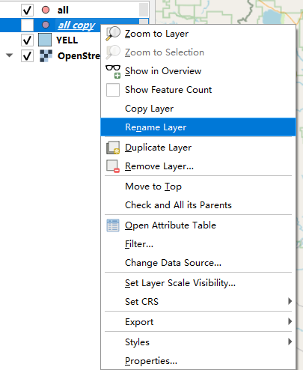
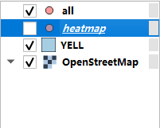
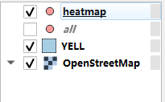
3
2
1
4

Slide 18
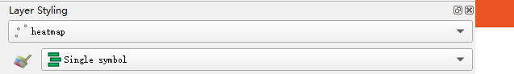
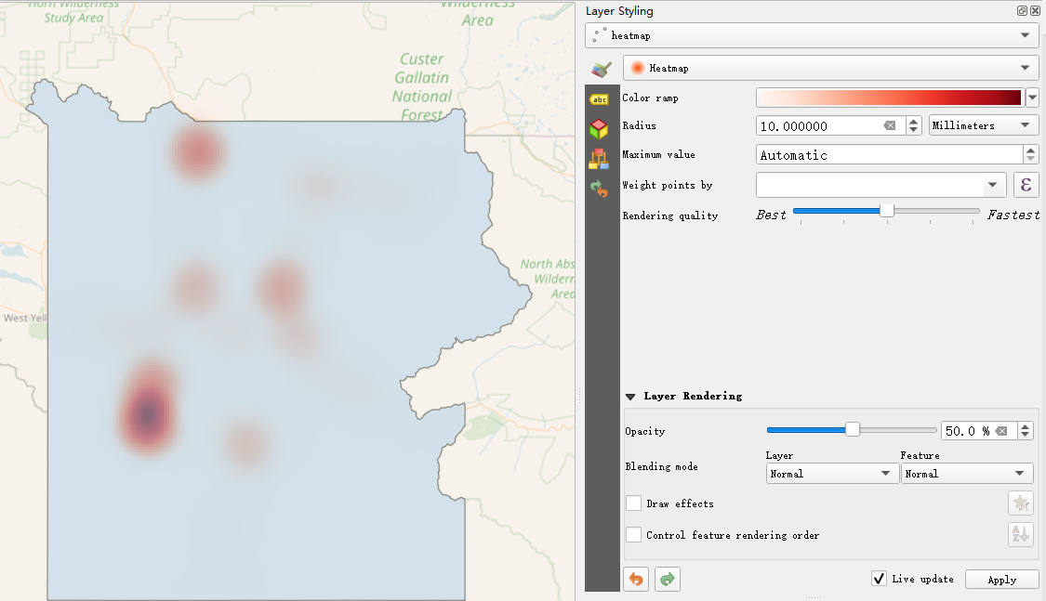
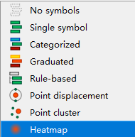
1
3
2
4
5

Slide 19
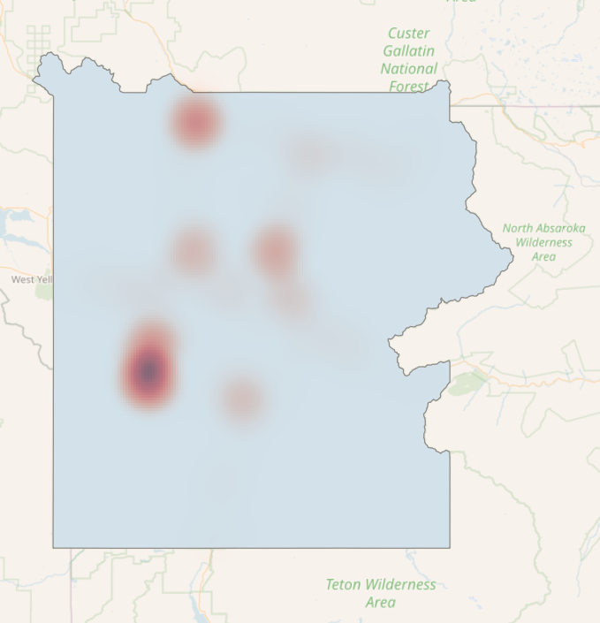

Slide 20
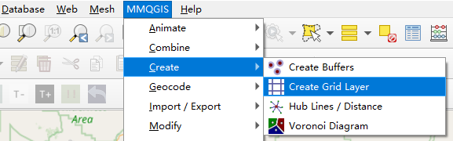
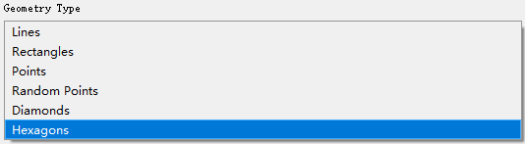
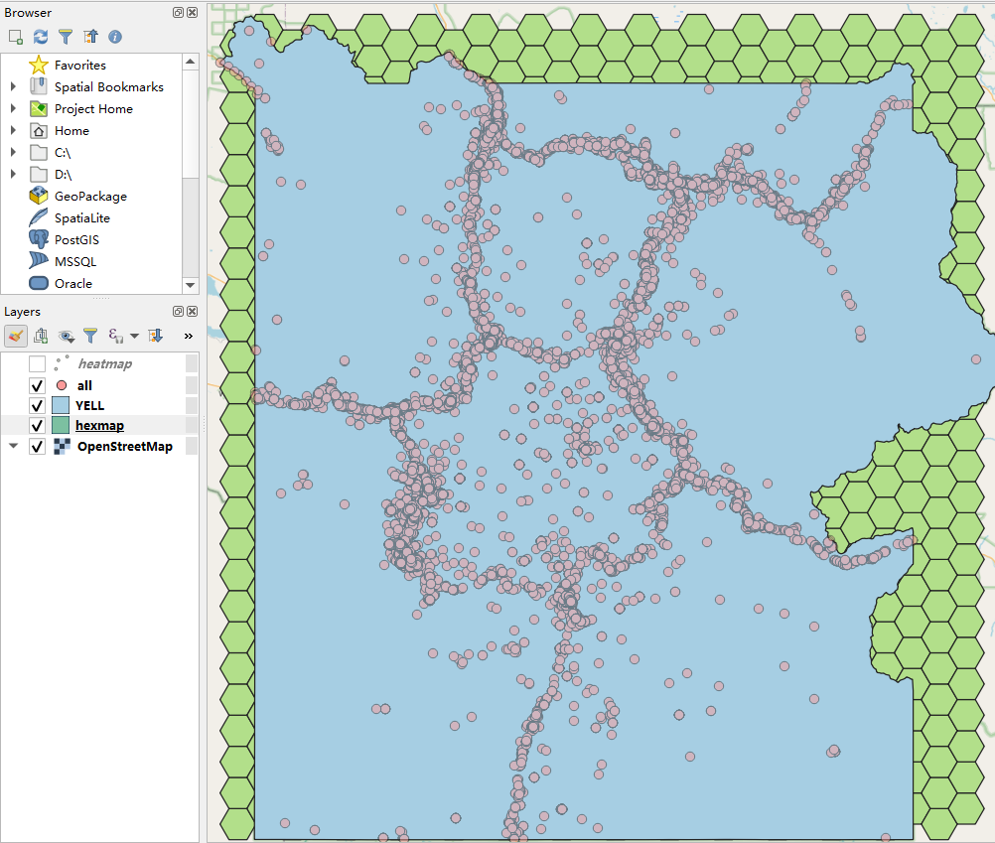
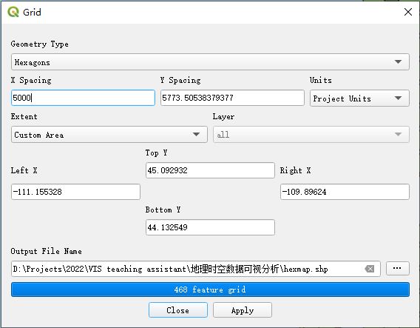
1
2
4
3

Slide 21
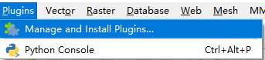
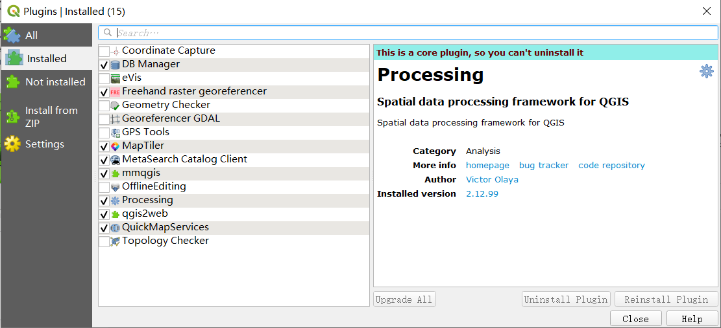
1
2

Slide 22
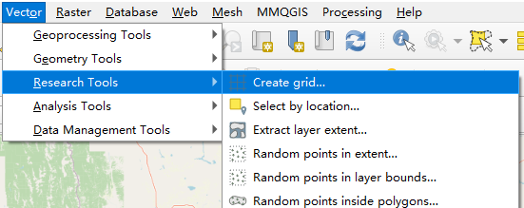
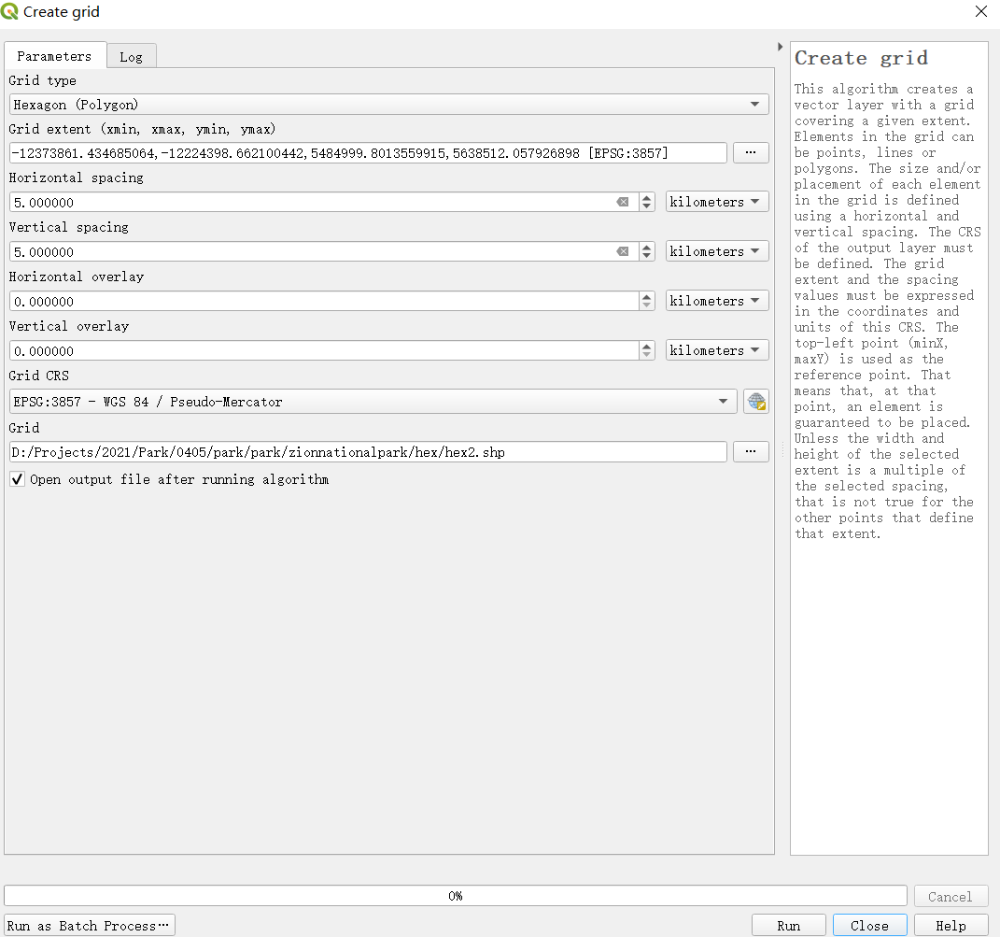
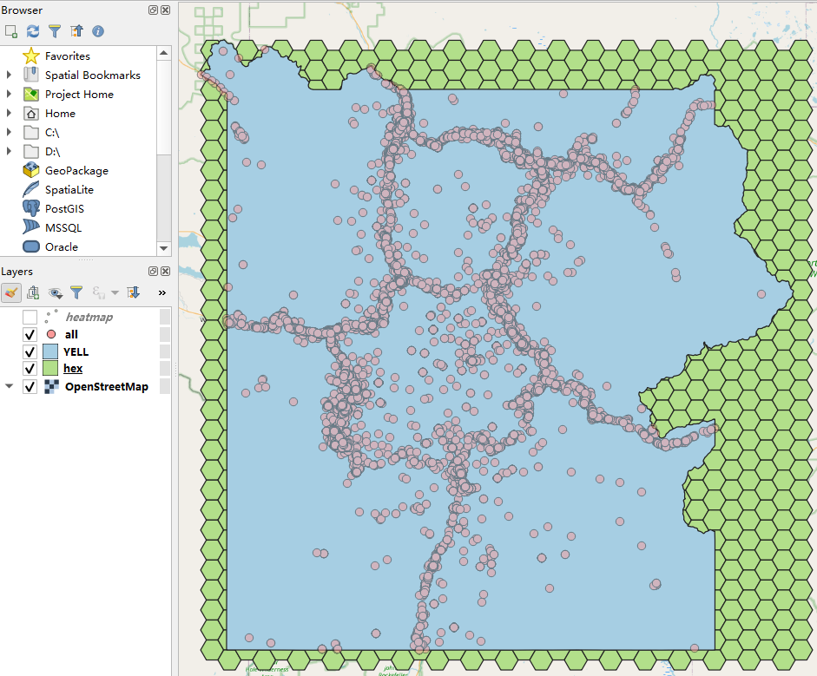
1
2
3

Slide 23
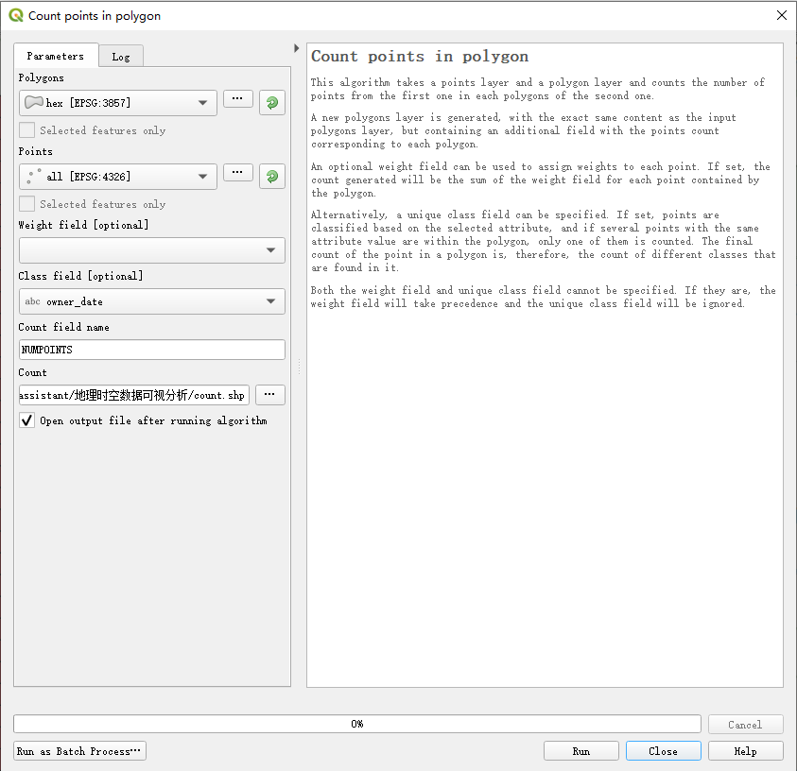
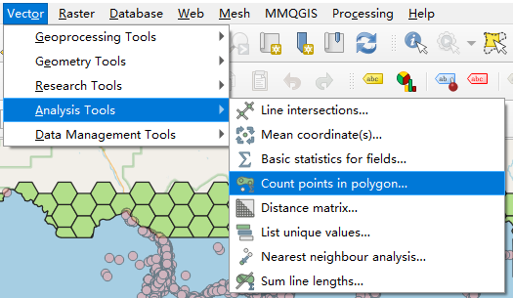
1
2

Slide 24


Slide 25








数据格式
免费获取
二进制，不易被D3解析
SHP文件
D3可解析
GeoJSON文件
Type
-(Multi)Point
-(Multi)LineString
-(Multi)Polygon
-GeometryCollection
-Feature(Collection)
…
消除冗余
大小-80%
TopoJSON文件

Slide 26






Azimuthal
Conic
Cylindrical
Composite
投影
d3.geoAlbersUsa()
d3. d3.geoAzimuthalEqualArea()
d3.geoAzimuthalEquidistant()
d3.geoGnomonic()
d3.geoOrthographic()
正射投影
d3.geoStereographic()
d3.geoEqualEarth()
方位角投影
圆锥投影
圆柱投影
d3.geoAlbers()（US-centric）
d3.geoConicConformal()
d3.geoConicEqualArea()
亚尔勃斯投影（等积圆锥投影）
d3.geoConicEquidistant()
d3.geoEquirectangular()
d3.geoMercator() 墨托卡投影
d3.geoTransverseMercator()
d3.geoNaturalEarth1()

Slide 27




蜂窝网格

Slide 28




d3.join
粗粒度
细粒度
等价

